Slide 1
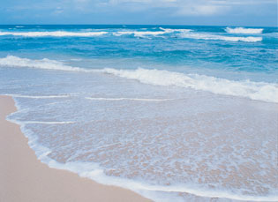
Ocean Tides
Lingixang Yu
09/29/2014

Slide 2
Main Reference
Redfield, Alfred C. Introduction to Tides: The Tides of the Waters of New England and New York. Woods Hole, MA: Marine Science International, 1981. Print
Schureman, Paul. Manual of Harmonic Analysis and Prediction of Tides. Washington: U.S. G.P.O., 1958. Print.
"Tide." Wikipedia. Wikimedia Foundation, 18 Sept. 2014. Web. 22 Sept. 2014.
"Tides and Water Levels." NOAA's National Ocean Service Education: Tides and Water Levels. National Ocean and Atmospheric Administration, n.d. Web. 22 Sept. 2014.

Slide 3
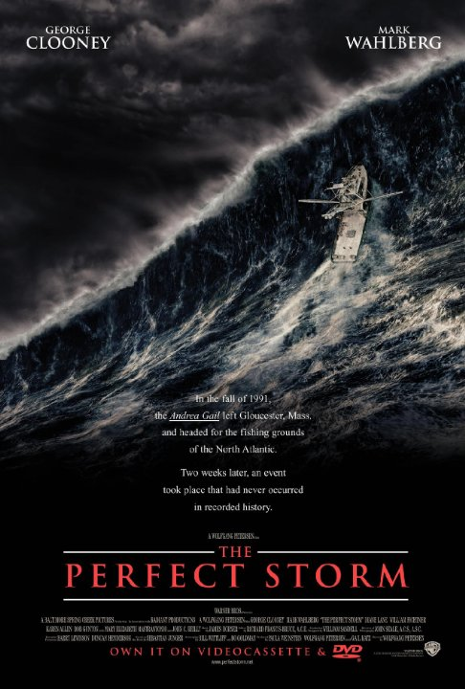
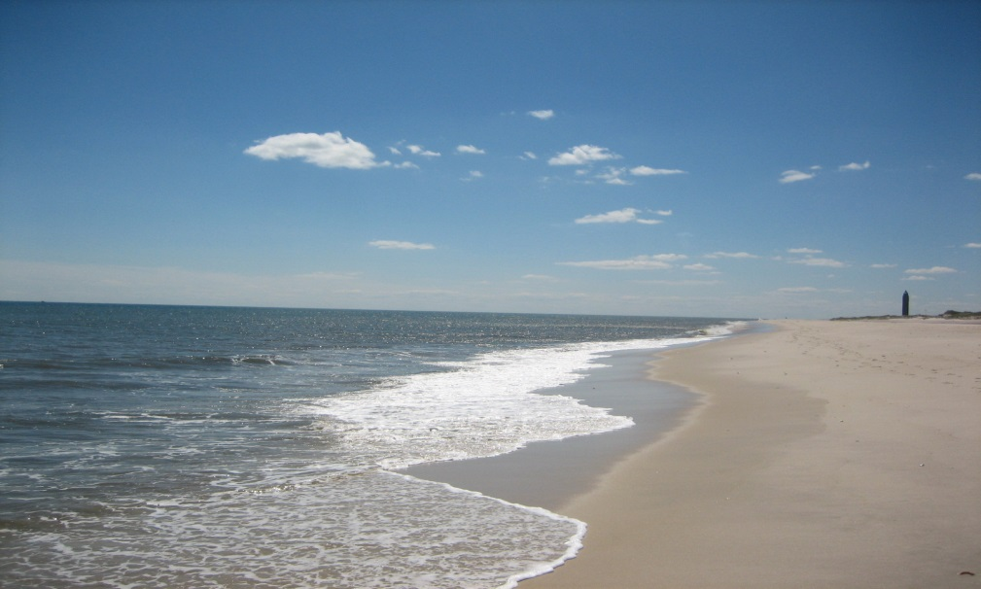
Why Ocean Tides
I grew up in an inland city
Got to see how beautiful the sea is in 2009
Love the movie, The Perfect Storm

Slide 4
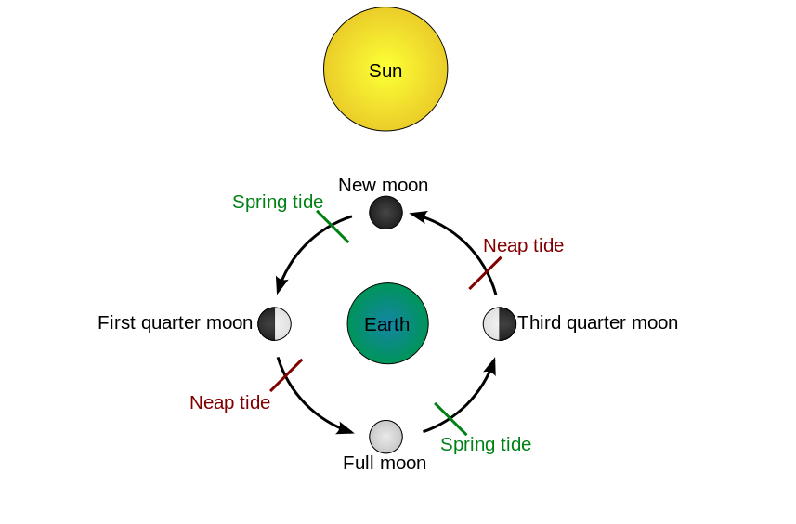
The Origin of Tides
Tides are caused by small differences which mainly result from the rotation of the Earth, and the gravity from the Sun and the Moon.
“The gravitational (tractive) forces due to the moon and sun tend to move the water toward the position immediately underlying the body”(Redfield 1).
http://en.wikipedia.org/wiki/Tide#mediaviewer/File:Tide_schematic.svg

Slide 5
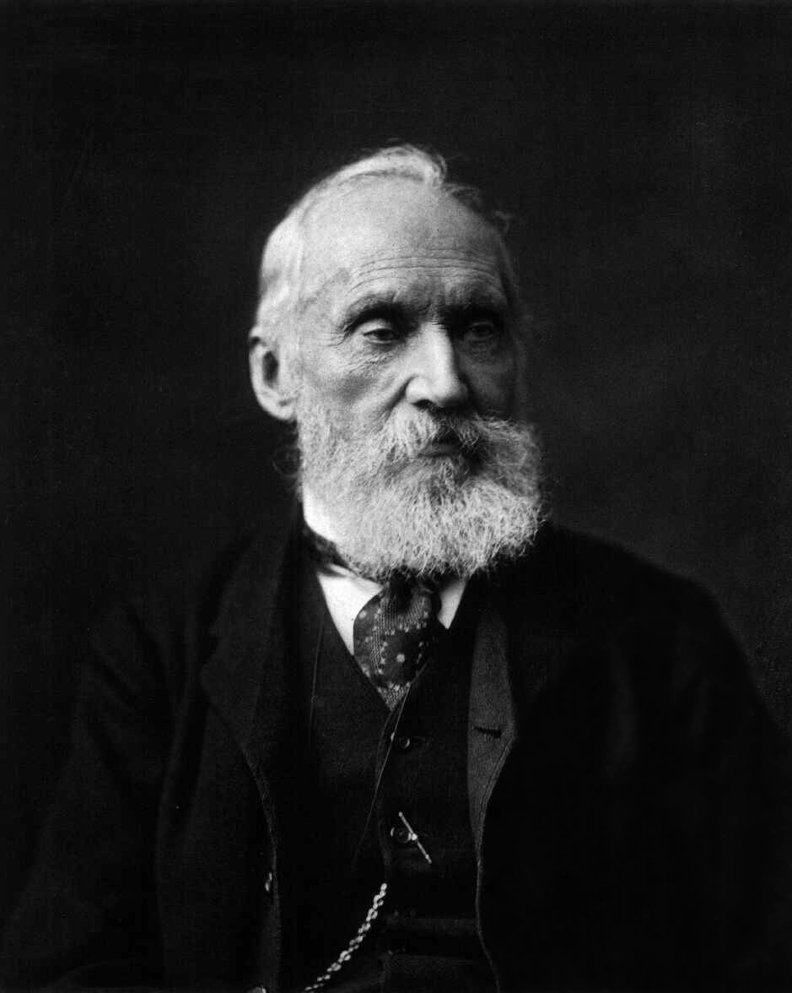
Harmonic Analysis
In order to study how tides could change under the influences of tractive forces from Moon and Sun, we need to use harmonic analysis.
Sir William Thomson was the first to apply for harmonic analysis on the ocean tides.
http://en.wikipedia.org/wiki/William_Thomson,_1st_Baron_Kelvin#mediaviewer/File:Lord_Kelvin_photograph.jpg

Slide 6
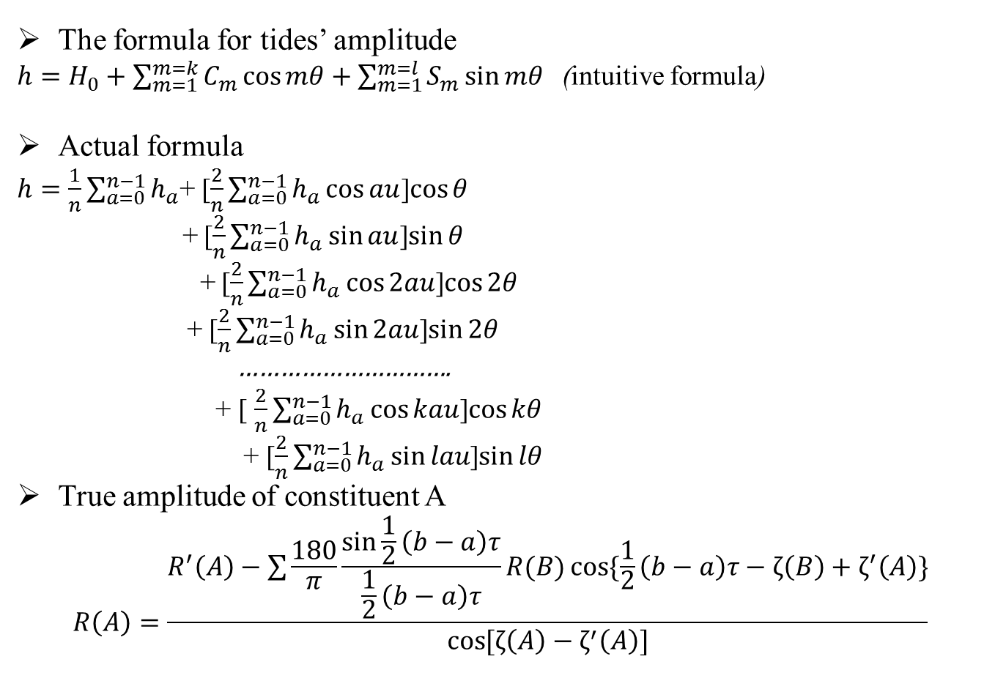
Harmonic Analysis
The formula for tides’ amplitude
$h=H_{0}+\sum_{m=1}^{m=k}{C_{m}\cos{mθ}+\sum_{m=1}^{m=l}{S_{m}\sin{mθ}}}$ (intuitive formula)
Actual formula
$h=\frac{1}{n}\sum_{a=0}^{n−1}{h_{a}}$+ [$\frac{2}{n}\sum_{a=0}^{n−1}{h_{a}\cos{au}}$]$\cos{θ}$
+ [$\frac{2}{n}\sum_{a=0}^{n−1}{h_{a}\sin{au}}$]$\sin{θ}$
+ [$\frac{2}{n}\sum_{a=0}^{n−1}{h_{a}\cos{2au}}$]$\cos{2θ}$
+ [$\frac{2}{n}\sum_{a=0}^{n−1}{h_{a}}\sin{2au}$]$\sin{2θ}$
………………………….
+ [ $\frac{2}{n}\sum_{a=0}^{n−1}{h_{a}}\cos{kau}$]$\cos{kθ}$
+ [$\frac{2}{n}\sum_{a=0}^{n−1}{h_{a}}\sin{lau}$]$\sin{lθ}$
True amplitude of constituent A
$$R\left(A\right)=\frac{R^{′}\left(A\right)−\sum{\frac{180}{π}\frac{\sin{\frac{1}{2}\left(b−a\right)τ}}{\frac{1}{2}\left(b−a\right)τ}R(B)\cos{\{\frac{1}{2}\left(b−a\right)τ−ζ\left(B\right)+ζ^{′}\left(A\right)\}}}}{\cos{[ζ\left(A\right)−ζ^{′}\left(A\right)]}}$$

Slide 7
Tidal Constituents
By using the Harmonic analysis, we can determine the change of amplitude of a constituent.
Here is another important terminology, Tidal Constituents.
“Tides can be conceived as the composition of the sum of a number of harmonic constituents having the same periods as those found in the tide-producing force”(Shureman, 49).

Slide 8
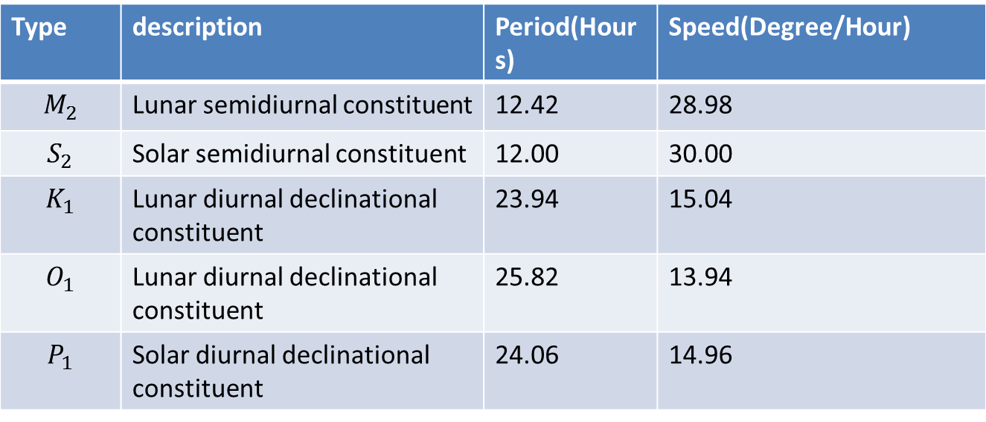
Tidal Constituents
Types of Constituents
Type | description | Period(Hours) | Speed(Degree/Hour)
$$M_{2}$$ | Lunar semidiurnal constituent | 12.42 | 28.98
$$S_{2}$$ | Solar semidiurnal constituent | 12.00 | 30.00
$$K_{1}$$ | Lunar diurnal declinational constituent | 23.94 | 15.04
$$O_{1}$$ | Lunar diurnal declinational constituent | 25.82 | 13.94
$$P_{1}$$ | Solar diurnal declinational constituent | 24.06 | 14.96

Slide 9
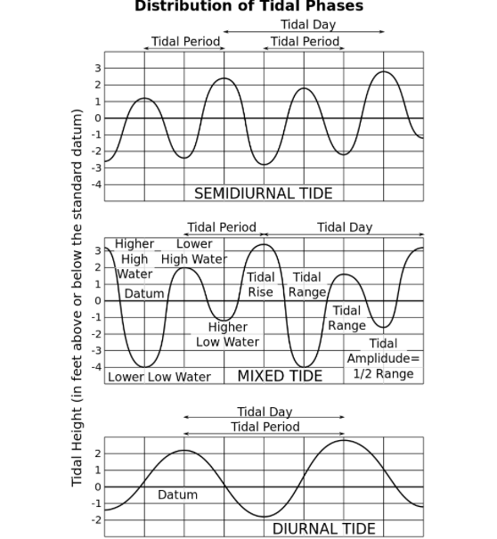
Tidal Constituents
http://en.wikipedia.org/wiki/Tide#mediaviewer/File:Tide_type.svg

Slide 10
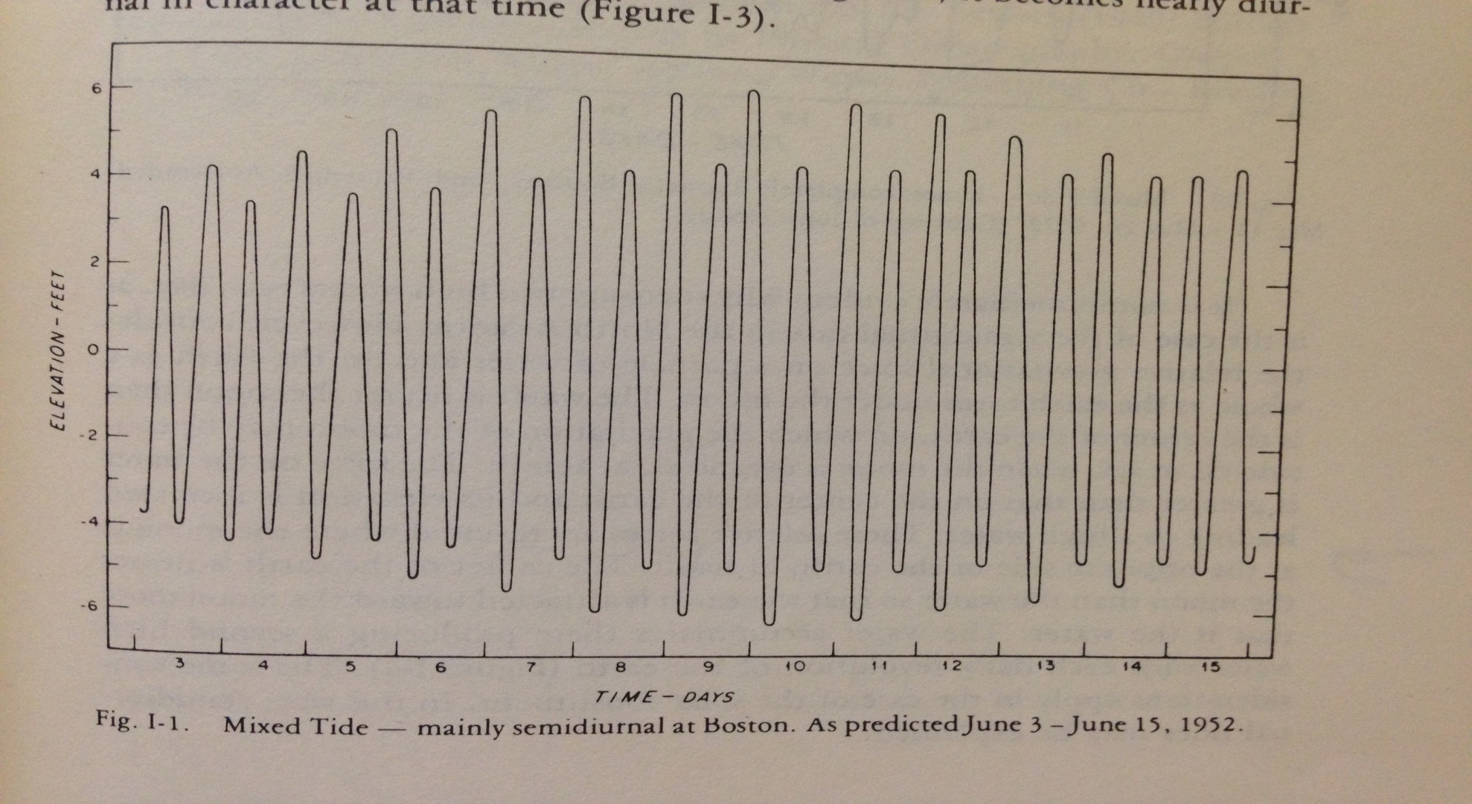
Tidal Constituents
Figure I-1 from Redfield’s book

Slide 11
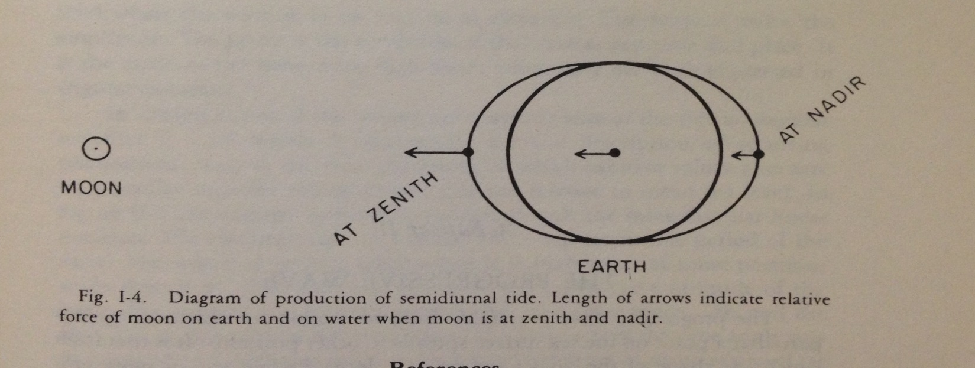
Tidal Constituents
Why are there two high waters each day in the above figure?
Figure I-4 from Redfield’s book

Slide 12
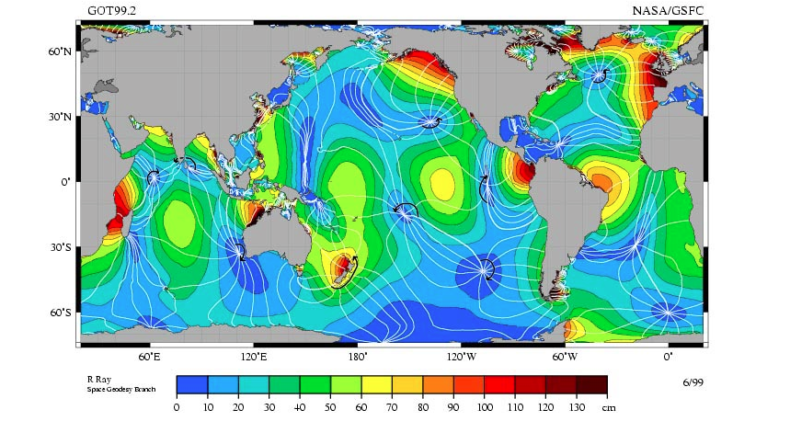
Other Factors Influence Tides
Amphidromic point
http://en.wikipedia.org/wiki/Tide#mediaviewer/File:M2_tidal_constituent.jpg

Slide 13
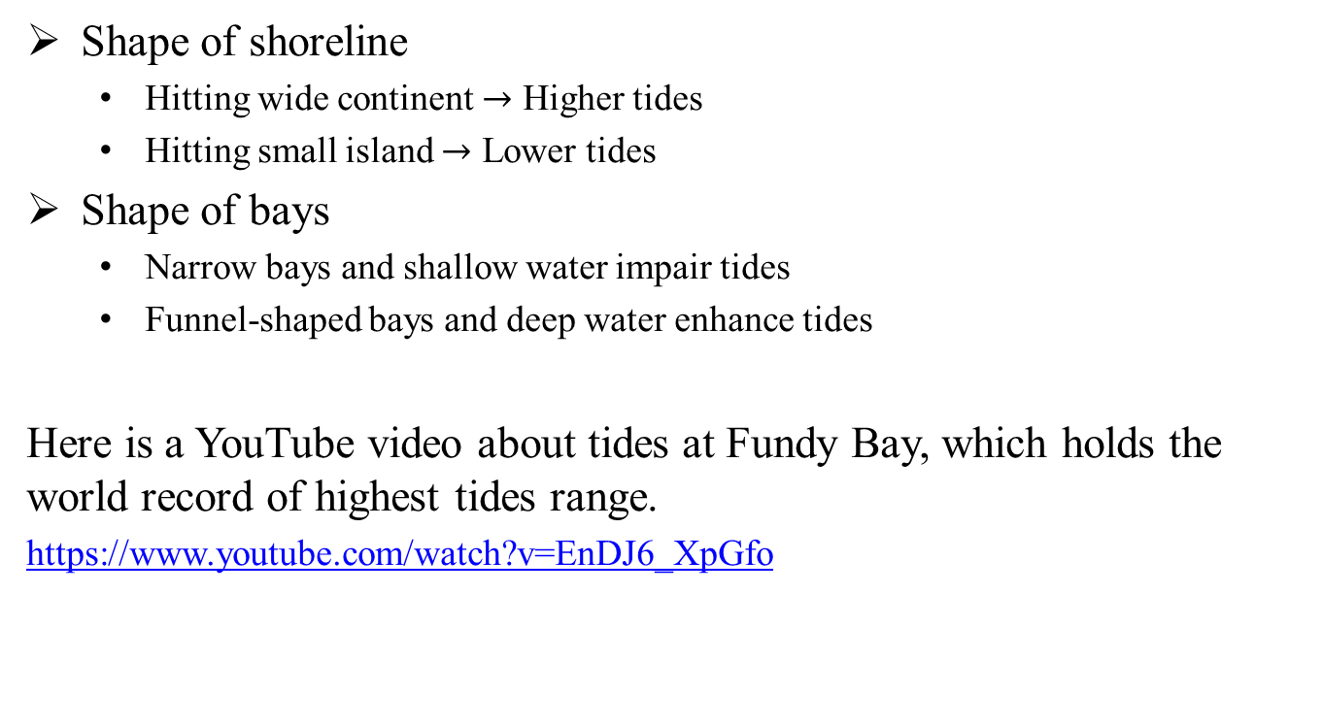
Other Factors Influence Tides
Shape of shoreline
Hitting wide continent $→$ Higher tides
Hitting small island $→$ Lower tides
Shape of bays
Narrow bays and shallow water impair tides
Funnel-shaped bays and deep water enhance tides
Here is a YouTube video about tides at Fundy Bay, which holds the world record of highest tides range.
https://www.youtube.com/watch?v=EnDJ6_XpGfo

Slide 14
Prediction
First of all, we need to deduct the formula for tides’ amplitude.
My main reference is Paul Schureman’s book, and his book is based on Sir William Thomson’s works. Also this book is recommended by NOAA.

Slide 15
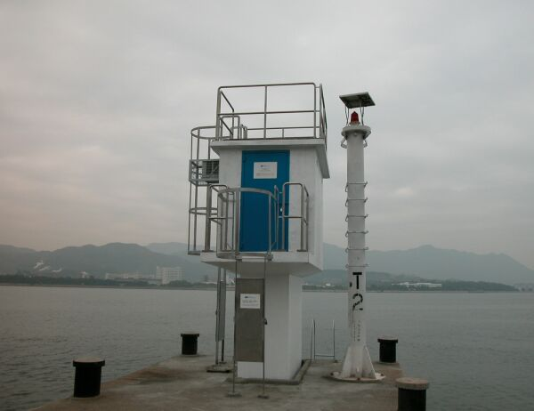
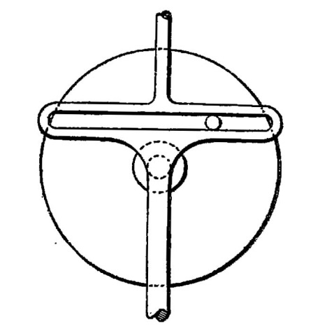
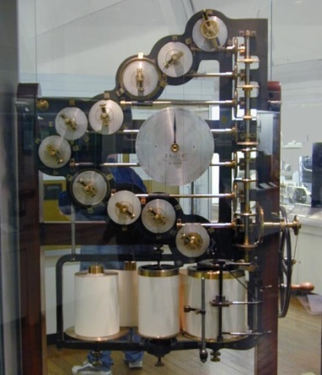
Tools are used in prediction process
Now we use Tide Gauge to measure the change in sea level, and even satellites. http://www.hko.gov.hk/wxinfo/news/2005/pre0120e.htm
People used to use Tides Machines to predict tides.
http://en.wikipedia.org/wiki/Tide-predicting_machine#mediaviewer/File:099-tmpshaft.jpg
http://en.wikipedia.org/wiki/Tide-predicting_machine#mediaviewer/File:DSCN1739-thomson-tide-machine.jpg

Slide 16
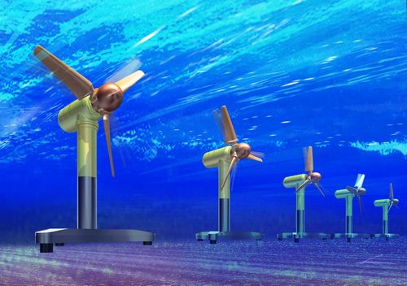

Application
Renewable energy is a crucial factor for our future. Tidal power provides us a new way to solving the energy problem.
$$P=\frac{1}{2}ρμ^{3}$$
Tidal power plants around the world
http://en.openei.org/wiki/Marine_and_Hydrokinetic_Technology_Database
http://www.japanfs.org/ja/files/Tidal_Power_Generation_System.jpg

Slide 17
Application
Safe navigating and construction in seas
Influence on ocean currents---this has connection with Amphidromic point.

